Slide 1
Grow Your Future Workforce
Fill in location &
date
Add sposor
Logo’s

Slide 2
Is your current and future workforce everything you want and need it to be?
P-TECH delivers a robust talent pipeline to create a workforce with the skills you need.

Slide 3
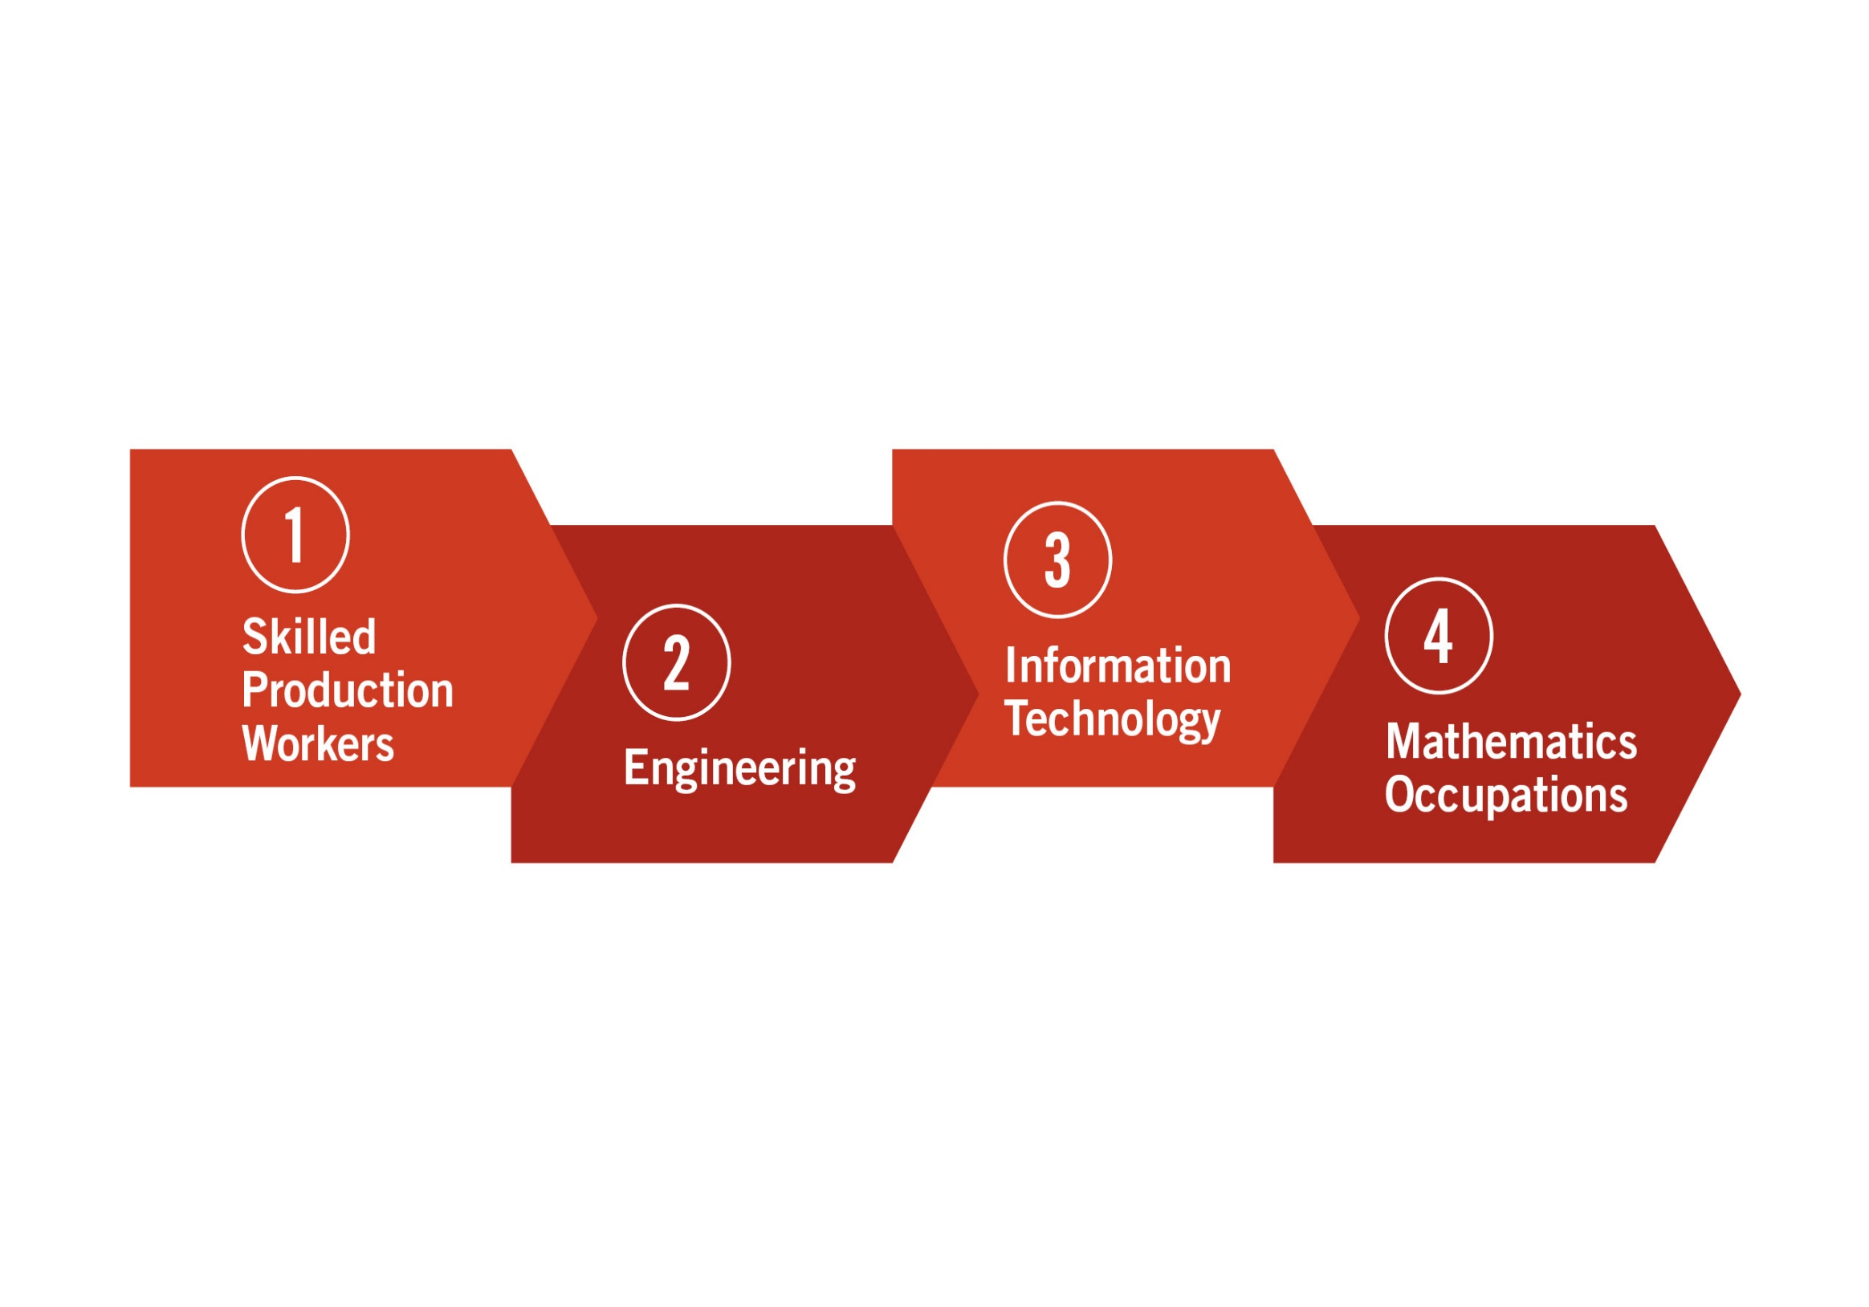
Hardest STEM Jobs to Fill

Slide 4
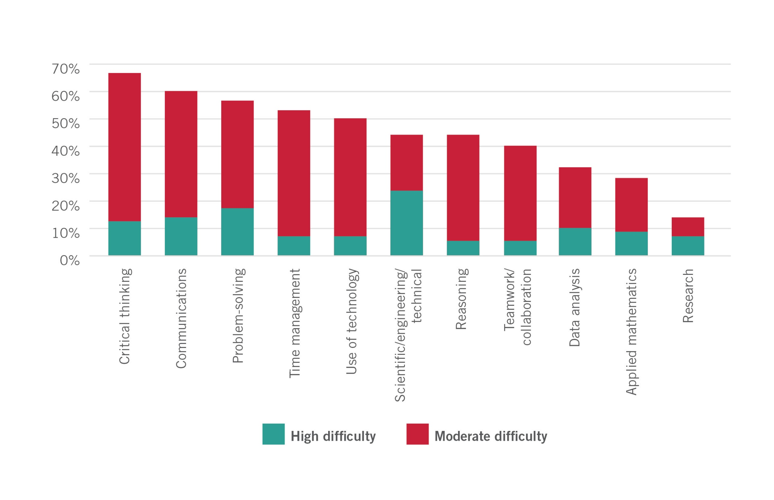
Skills Most Difficult to Find

Slide 5
P-TECH 9-14 Model
…brings together K-12 education, higher education and employers to offer an integrated six-year program.
Students complete a high school diploma, an industry-recognized/cost-free AA/AAS degree, and relevant work experience.
The seamless program delivers the rigorous academic, technical, and professional skills that employers need in middle jobs.

Slide 6
What Distinguishes NYS P-TECH?
Everything starts with the industry and the career – where are the middle skills jobs?
Employers are full partners from day one
Work-Based Learning and Professional skills are integral to the program
Focus on completing the industry-recognized college degree

Slide 7
P-TECH Graduates will Master these Professional Skills
PERSONAL TRAITS
Integrity
GROUP EXPERIENCE
Negotiation
Applied Knowledge
PROBLEM SOLVING
Dependability
Persistence
Responsiveness
Teamwork
Diversity
Communication
Flexibility
Planning
Continuous Improvement

Slide 8
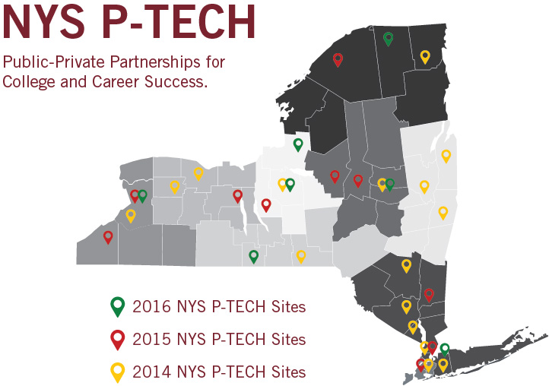

Slide 9
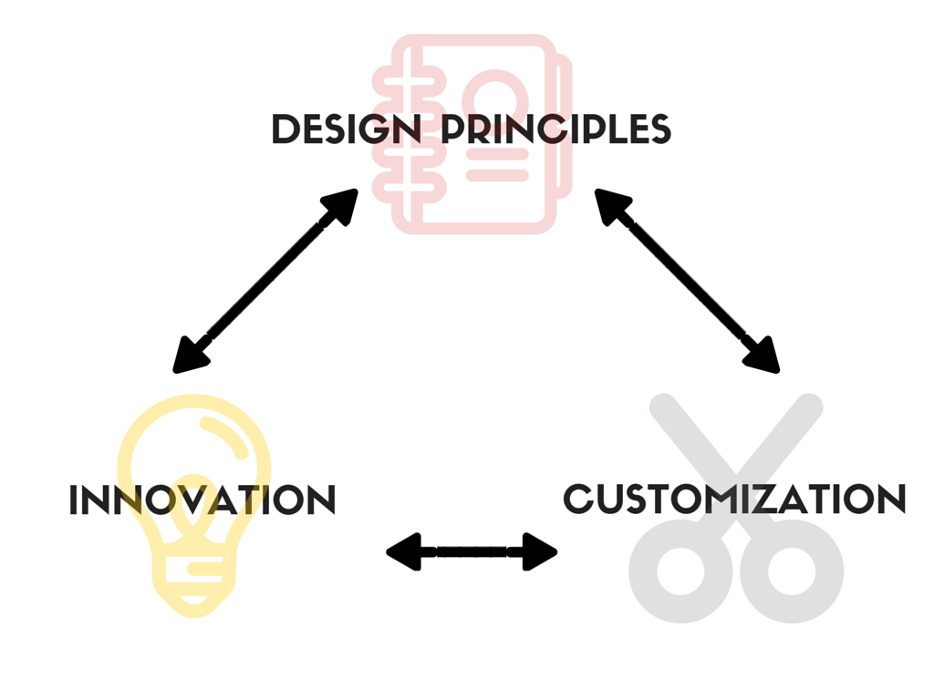
NYS P-TECH: NEW MODELS

Slide 10
Show Logo’s of sponsor schools, partners

Slide 11
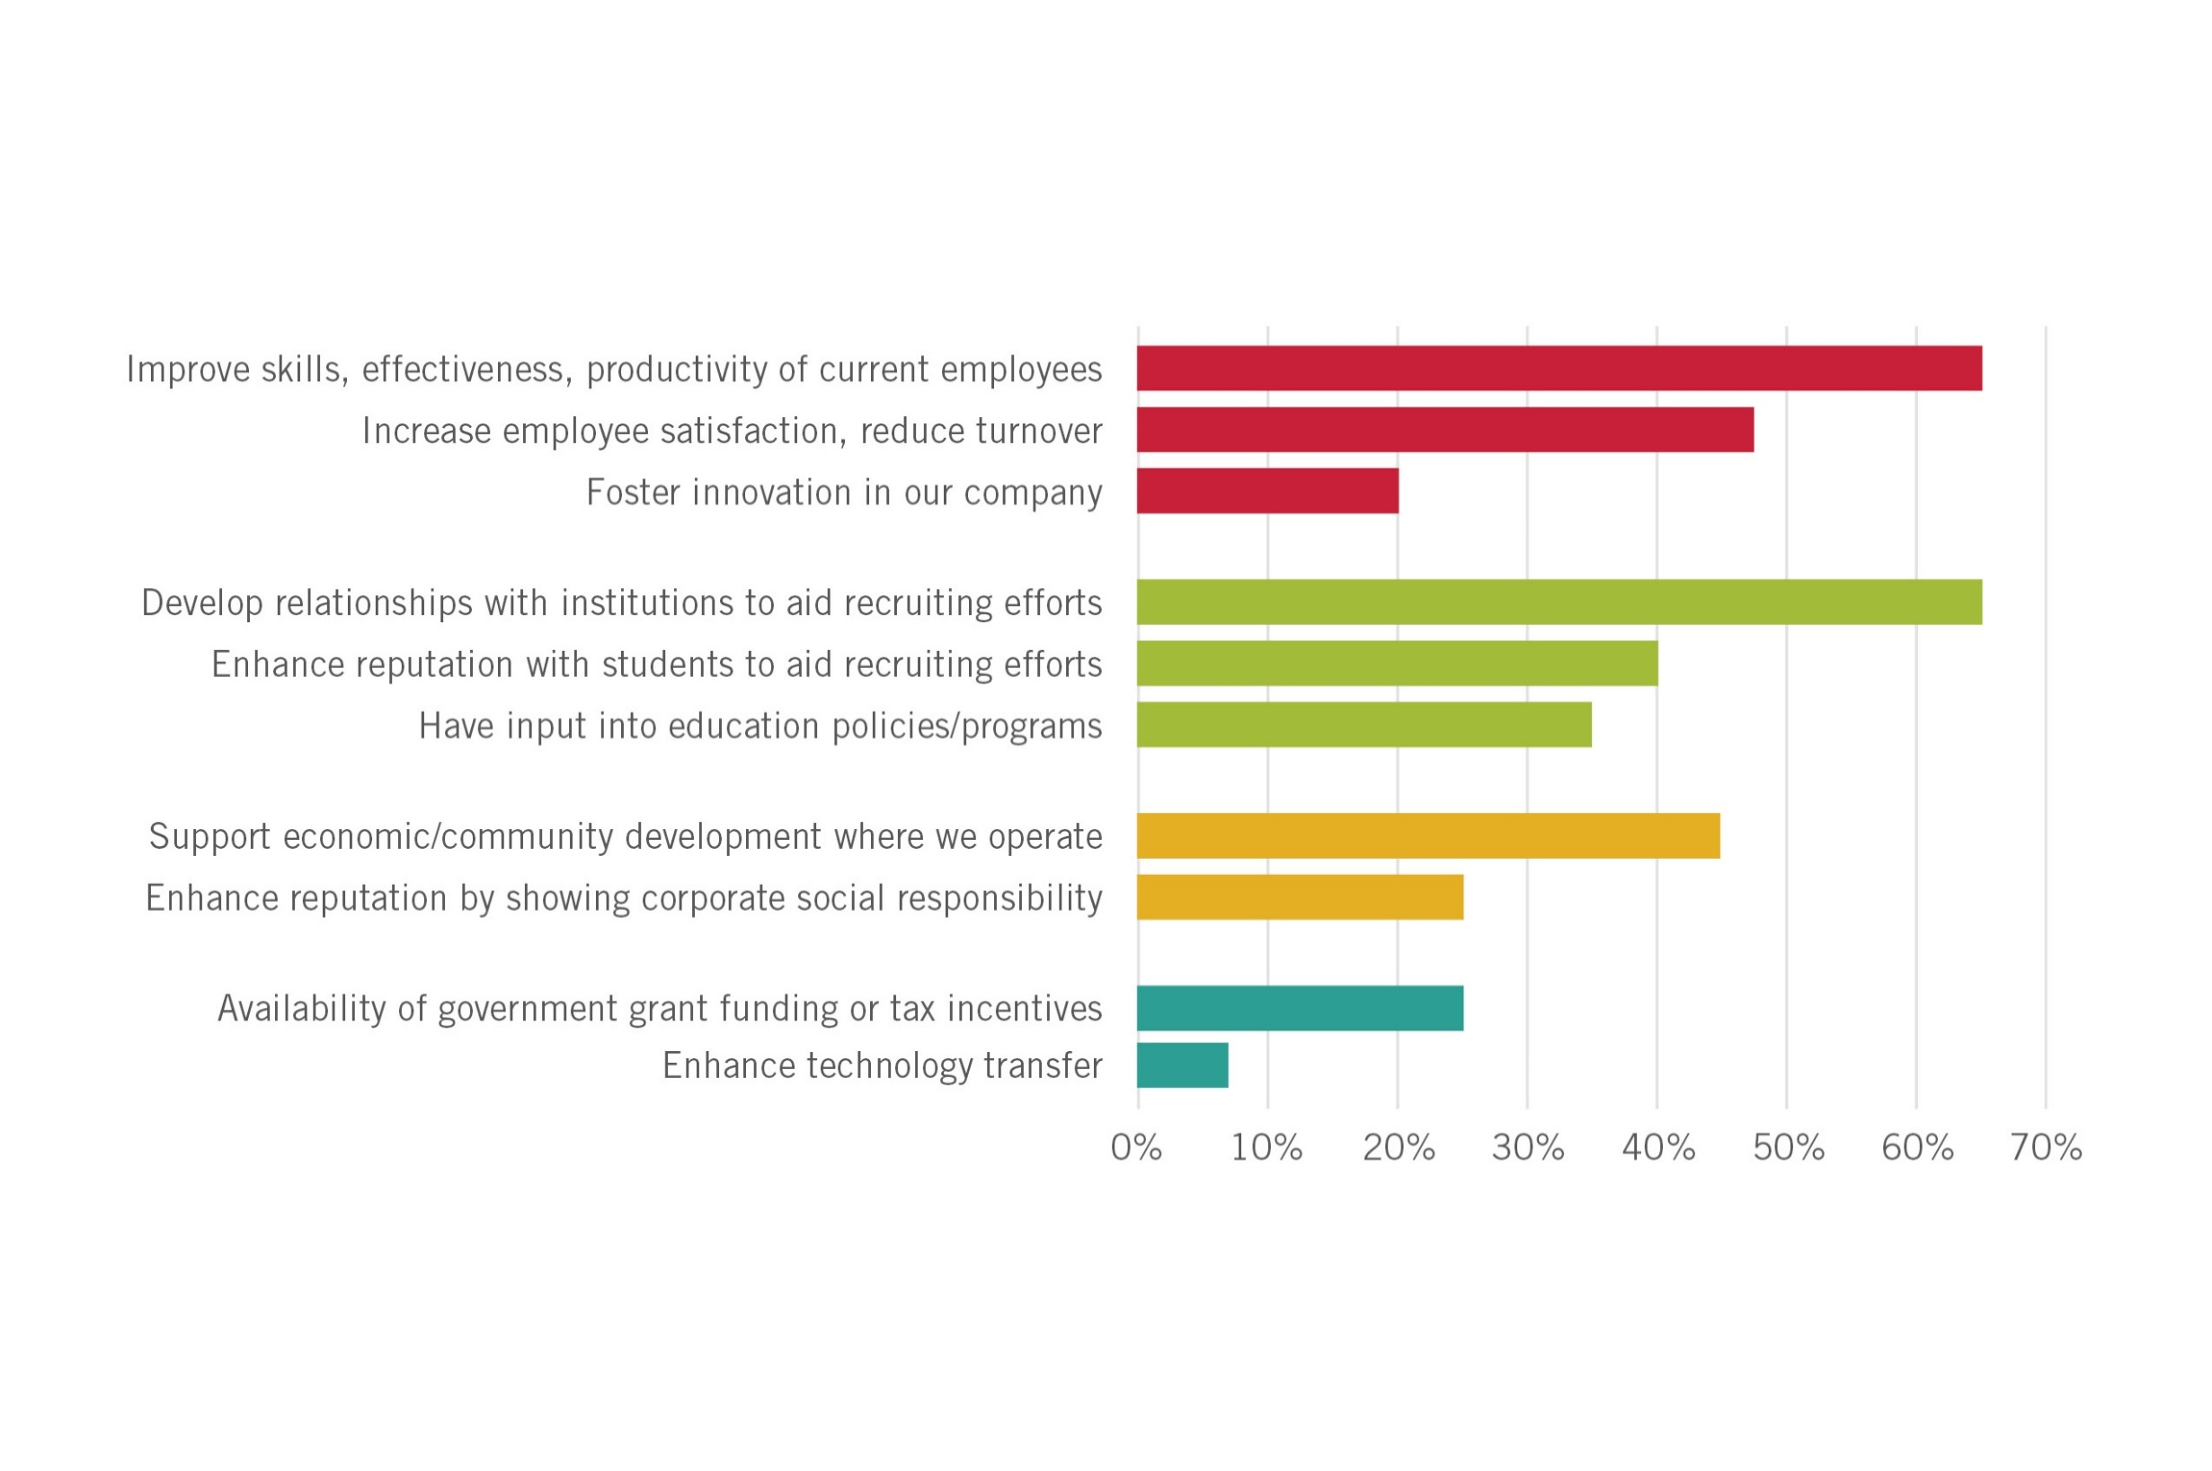
Top Reasons to Partner

Slide 12
P-TECH Employers Commit to Provide
Input for skills mapping
Validation for the course of study
Internships for eligible students
Opportunity for students who successfully complete the program to be first in line for jobs
Workplace exposure/visits
Career mentors
Workplace Challenges

Slide 13
Thank you!

