Slide 1
Tuesdays at 6:00 pm Thursdays at 12:00 pm on ZOOM

Slide 2
Office of Family Engagement Jaime Alicea, Superintendent April 28, 2020 Rachel Fleming, Administrative Aide

Slide 3
Family Engagement Facilitators
Mary Lisa Wade
Selina Lazarus
Luberta Crouch
Nina Vergara
Notes:
Introduce OFE members present.
Give instructions for the Beliefs survey

Slide 4
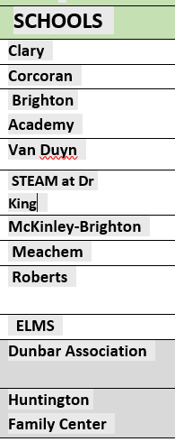
Family Engagement Facilitators
Mary Lisa Wade
315-380-8759
Notes:
Introduce OFE members present.
Give instructions for the Beliefs survey

Slide 5
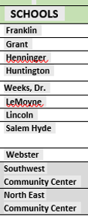
Family Engagement Facilitators
Selina Lazarus
315-372-2380
Notes:
Introduce OFE members present.
Give instructions for the Beliefs survey

Slide 6
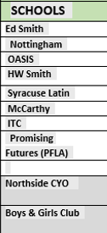
Family Engagement Facilitators
Luberta Crouch
315-350-6920
Notes:
Introduce OFE members present.
Give instructions for the Beliefs survey

Slide 7
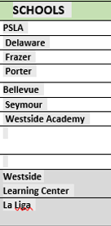
Family Engagement Facilitators
Nina Vergara
315-372-2886
Notes:
Introduce OFE members present.
Give instructions for the Beliefs survey

Slide 8
PROGRAM AIDES ATTENDANCE ASSISTANTS SOCIAL WORK ASSISTANTS

Slide 9
OFE @ SCHOOLS
Bellevue/Porter Suad Amer Samer@scsd.us
PSLA Lul Hassan Lhassan@scsd.us
Webster/Lemoyne Lisa Seaton Lseaton@scsd.us
Salem Hyde / Huntington Melissa Hidek Mhidek@scsd.us
Meachem / Van Duyn Khaliah Major Kmajor@scsd.us
Grant Tavon Goddard Tgoddard@scsd.us
Seymour Essence Cooper Ecooper@scsd.us
Ed Smith Emily Hart-Gorman EHart-Gorman@scsd.us
Oasis/ PFLA Harmony Johnson Hjohnson@scsd.us
HW Smith Malaysia Cole Mcole@scsd.us
Clary Lucas Encarnacion LEncarnacionIrizarry@scsd.us
Notes:
I’m going to show you a video of what is possible when we encourage our children and allow them to explore the world around them.

Slide 10
OFE @ SCHOOLS
Tyra Briggs
Steve Alleyne
Syracuse STEM at Blodgett
Brighton Academy Middle School
Lincoln Midle School
STEAM at Dr. King Elementary School
Delaware Primary School
Frazer PK-8
Henninger High School
Dr. Weeks Elementary School
Henninger High School
Nottingham High School
Corcoran High School
PSLA
Notes:
I’m going to show you a video of what is possible when we encourage our children and allow them to explore the world around them.

Slide 11
Join us on FaceBook at @scsdparentuniversity and at @SCSDFamilyEngagement

Slide 12
LEARNING WITH WCNY

Slide 13
How Can I Get My Questions Answered or Share a positive comment?

Slide 14
SURVEY CALLS ARE BEING MADE… NOW

Slide 15
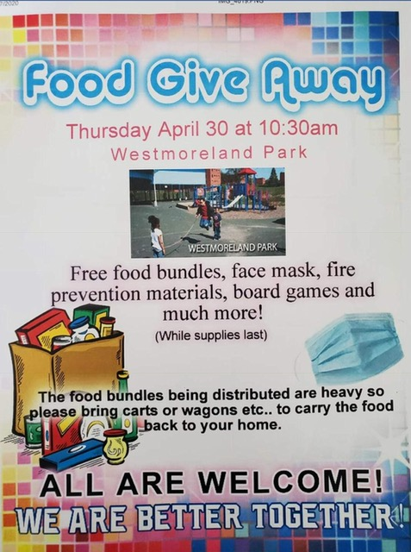
MEAL PROVISION & COMMUNITY OPTIONS
NON-SCSD OPPORTUNITY

Slide 16
Coming Up Next on Friday at 12:00 pm

Slide 17
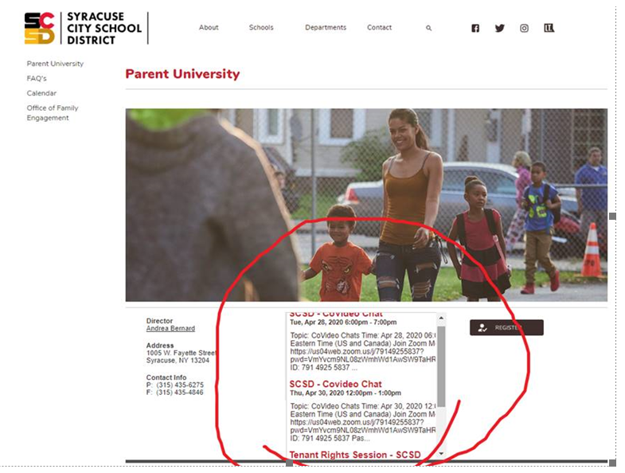
FUTURE TOPICS:
4th Quarter Grading Explained
How to Engage Children Academically
Mental Health during the Pandemic and Beyond
CANVAS – What is it and How can I Help My Child?
SUGGESTIONS??????
Notes:
Think of engagement this way

Slide 18
WE CAN GET THROUGH THIS TOGETHER!
THANK YOU FOR JOINING US! HOPE TO SEE YOU AGAIN!

Slide 19
QUESTIONS?
If schools were to open in May, would you send your child(ren) to school? Why, or why not?
Following this ‘shut-in’, do you think your interactions with your child’s school will be different? What about your involvement – is there anything you would change?
Have you noticed anything new about your child’s learning style (what works, what doesn’t etc)?
Have you used the WCNY programming?

