Slide 1

Tuesdays at 6:00 pm
Thursdays at 12:00 pm on ZOOM

Slide 2
Special Education:
Hybrid School Model
Jaime Alicea, Superintendent of Schools
August 2020

Slide 3
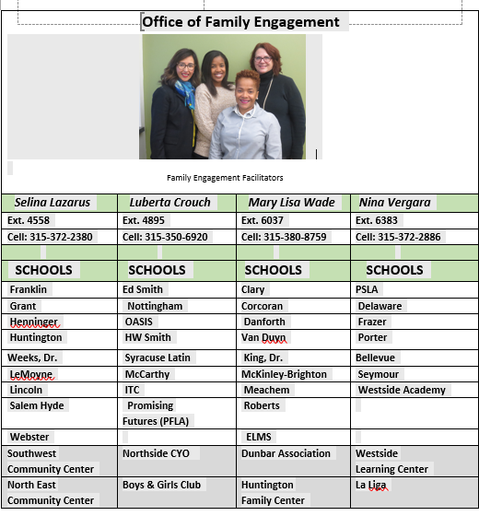
Family Engagement Facilitators
Mary Lisa Wade
Selina Lazarus
Luberta Crouch
Nina Vergara
Notes:
Introduce OFE members present.
Give instructions for the Beliefs survey

Slide 4
Elementary Special Education Model
Students in special class (6:1:1, 8:1:1, ,12:1:1, 15:1, 12:1:3:1) will attend Monday, Tuesday, Thursday, and Friday.
Preschool students in special class integrated settings and special education itinerant teacher programs-inclusion (SCIS/SEIT-inclusion) will attend Monday, Tuesday, Thursday and Friday.
Students in CT and ICT programming will follow the building hybrid schedule.
Students in Special Education Itinerant teacher programs and related service only will follow the building hybrid schedule.
On remote learning days, the special education teacher will provide small group lessons with the students via Microsoft Teams.
CT students who are alternatively assessed or have a 1:1 will attend four days per week. These students will be assigned to their pod for two days and will work with a special education teacher and a TA on the other two days, focusing on support with remote instruction assignments.

Slide 5
Elementary Special Education Model
Resource only students will follow each building’s hybrid schedule. Resource may be a mix of in person and remote services.
Every effort will be made to provide in person related services. Some students may have a mix of teletherapy and in person services depending on the frequency of services indicated on the IEP.

Slide 6
Middle School Special Education Model
Students in special class (6:1:1, 8:1:1, ,12:1:1, 15:1, 12:1:3:1) will attend Monday, Tuesday, Thursday, and Friday.
Students in CT and ICT programming will follow the building hybrid schedule.
On remote learning days, the special education teacher will provide small group lessons with the students via Microsoft Teams.
CT students who are alternatively assessed or have a 1:1 will attend four days per week. These students will be assigned to their pod for two days and will work with a special education teacher and a TA on the other two days, focusing on support with remote instruction assignments.

Slide 7
Middle School Special Education Model
Resource only students will follow each building’s hybrid schedule. Resource may be a mix of in person and remote services.
Every effort will be made to provide in person related services. Some students may have a mix of teletherapy and in person services depending on the frequency of services indicated on the IEP.
Mixed Programming – Students who attend special class for some subjects will be in school four days per week for special class instruction. The remainder of the four days will be spent with a special education teacher and TA to focus on completion of remote learning assignments.

Slide 8
High School Special Education Model
Students in special class (6:1:1, 8:1:1, ,12:1:1, 15:1, 12:1:3:1) will attend Monday, Tuesday, Thursday, and Friday.
CT teachers will pair with general education teachers to develop accommodations through Canvas. Special Educators will hold daily office hours for students to drop in and receive assistance or have concepts retaught.
CT students who are alternatively assessed or have a 1:1 will attend 4 days per week. During the four days, they will work with a special education teacher and a TA on remote learning assignments.

Slide 9
High School Special Education Model
Resource will be provided remotely. Each student will have a daily, scheduled resource session with a special education teacher in a group of 5 or less.
Every effort will be made to provide in person related services. Some students may have a mix of teletherapy and in person services depending on the frequency of services indicated on the IEP.
Mixed Programming – Students who attend special class for some subjects will be in school four days per week for special class instruction. The remainder of the four days will be spent with a special education teacher and TA to focus on completion of remote learning assignments.

Slide 10
Frequently Asked Questions
What PPE will be provide for special education teachers and students?
Face shields, masks, gowns, and masks with clear film around the mouth have been ordered for appropriate classrooms, staff and students. Dividers have been ordered for buildings and have been prioritized for speech therapy rooms.

Slide 11
Frequently Asked Questions
How will High School students accrue CDOS hours?
The Special Education Department has partnered with the NYSED Regional Partnership to provide job skill instruction to specific classrooms. CTE seat hours count towards CDOS and we will work to provide opportunities within school buildings where appropriate.

Slide 12
Frequently Asked Questions
How will you keep students with behavioral issues socially distanced?
We will work diligently to ensure safety measures for students and staff. Our Behavior Specialists will work with staff to coach them on ways to engage students with behavioral issues while keeping personal space and staying safe.

Slide 13
Frequently Asked Questions
How will a 1:1 be used during remote learning?
Students with 1:1 will be offered the opportunity to be in school for four days. If a parent chooses remote learning, the 1:1 will work with the teacher to support instruction and acquisition of the IEP goals. It will look different for each student.

Slide 14

QUESTIONS

