Slide 1
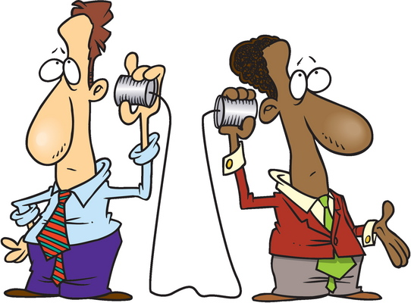
Communication

Slide 2
Communication
You Want Me To Build What?

Slide 3
Communications
It takes various teams to move projects through design, development, testing, and production.

Slide 4
Communications
The teams may be located in different buildings, states, or even different countries.
It is also possible that members of a single team may be separated.

Slide 5
Communications
So, it is important when communicating, to be clear and concise.

Slide 6
Communications
In this project, you will work with a partner.
Construct an object.
Write directions on how to build it.
Exchange directions and material with another group and build their object.

Slide 7
Communications
5 minutes - Construct your object.
5 minutes - Write a description of the object and directions on how to make it…and photograph it!
10 minutes - Trade materials and descriptions and attempt to build a recreation of the prototype object.
5 minutes - Compare what you built with the original designer.

Slide 8
Communications
When making your directions…
Use descriptive words and numbers.
All abbreviations must be defined either at the beginning or when the abbreviation is first used.

Slide 9
Now Compare…
Look at each other’s work, comparing the photo of the original prototype object to the recreation.
How did you do?

Slide 10
Questions
What was difficult for each team during the activity?
What was easy?
What communication, besides only written words and numerals, would have been helpful?
How might you have done this differently if you had been able to plan ahead?

